Slide 1
WRAP TSC/Co-Chairs Call
Workplan Progress Update
October 31st, 2018
Tribal Data WG
Fire and Smoke WG
Oil and Gas WG
Regional Technical Operations WG
Regional Haze Planning WG

Slide 2
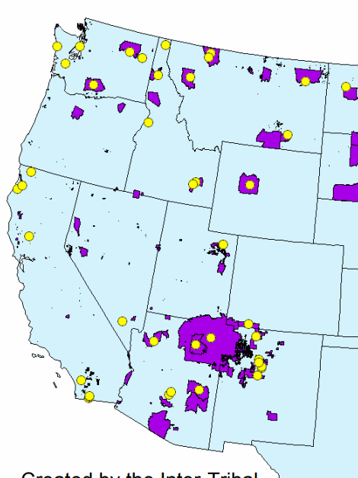
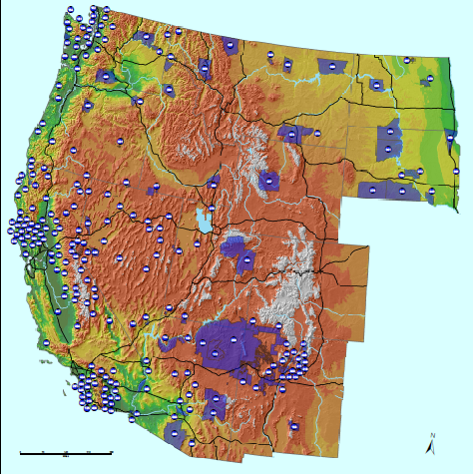
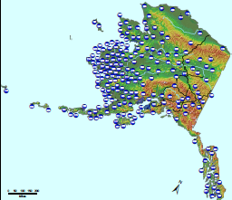
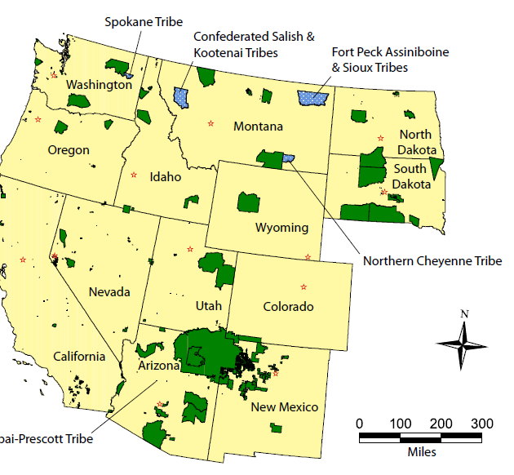
Tribal Data Work Group

Slide 3
Tribal Data Work Group
Co-Chairs: Kris Ray (Colville Tribes) and Emma Ruppell (Bishop Paiute Tribe)
Call Schedule: Monthly updates with committee and contractors
Website: http://www.wrapair2.org/tdwg.aspx (under development)
Current Tasks/Projects
  Working on the Tasks in the 2018 to 19 workplan
  Data analysis
  Outreach

Slide 4
Tribal Data Work Group Work Products and Next Steps
Contract with the Institute of Tribal Environmental Professional at Norther Arizona University; EN3 Professionals LLC
  General WRAP outreach for RH
  Contact list for Tribes in the WRAP area
  Map updating – create interactive maps and bring in new layers of information
  Tribal AQS data gap study – which Tribes submit data and identification of issues
  Tribal NEI data gap study – Identification of Tribes submitting to the NEI, Tribes conducting EI but not submitting
  Tribal oil and gas EI studies – in coordination with OGWG
  Consultation Protocol – process and timing of Consultation opportunities
  WRAP webinars - Two or three planned, regional haze, WRAP tools, AQS or EI data
Next Steps
  Monthly progress calls

Slide 5

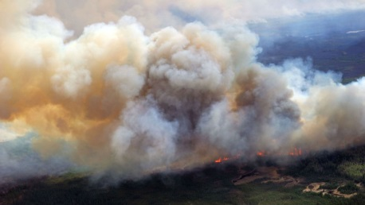
and
Fire and Smoke Work Group

Slide 6
Fire & Smoke Work Group
Co-Chairs: Sara Strachan, Josh Hall (on detail)
Call Schedule: monthly or as needed
Website: http://www.wrapair2.org/FSWG.aspx
Current Tasks/Projects
  2014 WRAP FNEI data review

Slide 7
Status Report for Fire & Smoke Work Group
2014 WRAP FNEI data review
  Approach
    Build an evaluation framework for states/tribes to review inventory
    Follow up individually as needed to solicit feedback
    Summarize results in a memorandum with recommendations for holistic inventory updates
  Status
    Deadline to receive feedback has passed
    Compiled a summary of States’ evaluations
    Will alter FNEI based on feedback as possible
  Milestones
    Plan to discuss feedback and evaluations on FSWG call on Oct. 29
  Coordination and Next Steps
    Incorporate feedback into inventory
    Coordinate with modelers about format
    Decide about new SCC categories to include, plume rise algorithm, pile burning, etc.

Slide 8
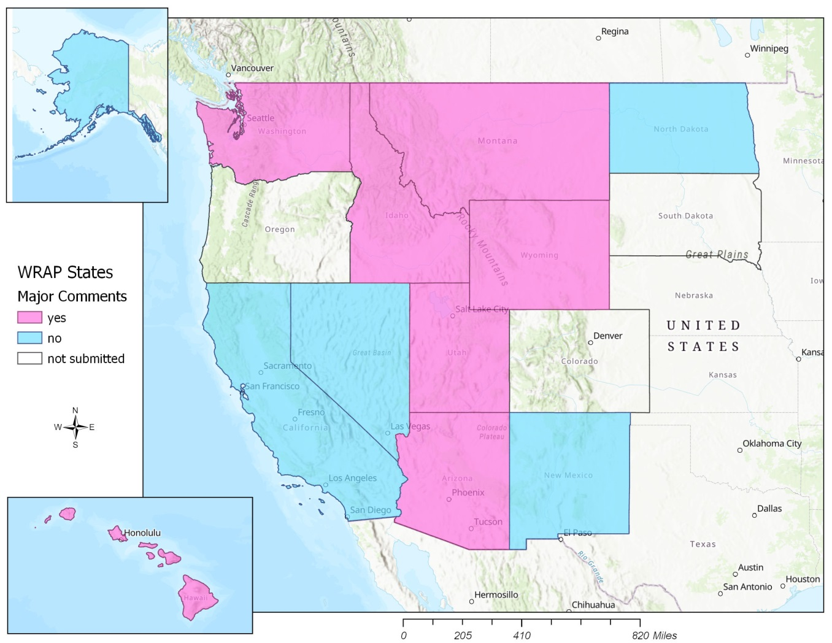
Status Report for Fire & Smoke Work Group

Slide 9
Oil and Gas Work Group

Slide 10
Oil and Gas Work Group
Co-Chairs: Amanda Brimmer, Mark Jones, and Darla Potter
Call Schedule:
  OGWG - 2nd Tuesday, every other month @ noon MT
    October 9, 2018
    December 11, 2018
  OGWG Project Management Team (PMT) Calls – as needed
    October 30
Website: https://www.wrapair2.org/OGWG.aspx
Current Tasks/Projects
  Road Map Phase II:
    Task 1: 2014 Base Year O&G Emissions Inventory
    Task 2: 2028 Forecast O&G Emissions Inventory (based on 2023)
      will include on-the-books (OTB) and on-the-way (OTW) controls

Slide 11
Status Report for Oil and Gas Work Group
Task 1: 2014 Base Year O&G Emissions Inventory
Approach: Contractor (Ramboll) performing work on following tasks: | Status/Deliverables
Inventory Compilation, Reconciliation, Data Gaps | Spreadsheet* + WG Discussion 8/14
2014 O&G Activity | Spreadsheet* + WG Discussion 8/14
Identify Emission Factors and Speciation Profiles for Oil and Gas Sources | PMT Discussion 8/20
State and industry survey | OGWG 10/9, PMT 9/28 & 10/30 WESTAR Council 10/10
Technical Improvements and Reporting | PMT Discussion 8/20
SMOKE-ready Emission Inventory Files | No work yet
Milestones:
Sept. 2018 – Literature review PowerPoint
Oct. 2018 – Survey finalized to send out
Apr. 2019 – SMOKE-ready 2014 O&G emissions inventory files
Coordination and Next Steps:
Assistance needed from States to complete survey (coordinate with local industry if needed)
OGWG and Project Management Team (PMT) review of draft work products
* Posted on OGWG webpage

Slide 12
Survey Overview
Survey will be filled-out in two phases
  Phase 1: Agencies fill-out survey based on internal data sets
  Phase 2: Operators fill-out survey (top 3-5 operators in each basin)

Slide 13
Status Report for Oil and Gas Work Group
Task 2: Forecast 2028 (OTB & OTW Controls) Oil & Gas Emissions Inventory
Approach: Contractor (Ramboll) performing work on following tasks: | Status
Identify historic growth, supply, demand, and production decline | No update
Identify a Range of Forecast Year Oil and Gas Scenarios | “
Identify Rule Penetration and Effectiveness for Oil and Gas Sources: National, State, Local, Tribal | “
Implement Regionally-Consistent 2028 Forecast (OTB & OTW controls) Emissions Inventory | “
SMOKE-ready Emission Inventory Files | “
Milestones:
May 2019 – Final Report
June 2019 – SMOKE-ready 2028 O&G emissions inventory files
Coordination and Next Steps:
OGWG and Project Management Team (PMT) review of draft work products

Slide 14
Regional Technical Operations Work Group

Slide 15
RTOWG Work Group
Co-Chairs:
  Gail Tonnesen (EPA R8)
  Kevin Briggs (CO CDPHE)
  Mike Barna (NPS ARD)
Call Schedule:
  Next call: 11/15/18
  RTOWG co-chairs participating in other workgroup calls
Website:
  http://www.wrapair2.org/RTOWG.aspx

Slide 16
Status Report for RTOWG
Western regional modeling platform RFP review
  Approach
    Overview of tasks in RFP for development of 2014 modeling system
  Status
    Review call 10/3/18
  Milestones
    Second review call 11/2/18
  Coordination and Next Steps
    Finalize tasks in RFP

Slide 17
Status Report for RTOWG
Regional Haze NASA HAQAST project
  Approach
    Use of satellite products to address issues relevant to regional haze
  Status
    Initial coordination call 10/29/18
  Milestones
    (see following slide)
  Coordination and Next Steps
    Monthly team calls

Slide 18
Status Report for RTOWG
Preliminary milestones for Regional Haze NASA HAQAST project
  (Tong) Dust – wordview tutorial on how to plot up dust events
  (Zondlo) Ammonia – regional maps showing spatial variations
  (Henze) Trends in NO2 – looking at Southwest/Mexico including TX
  (Fiore) Satellite analysis of international transport from Canada to NE US
  (Fiore/Duncan) Overview of information regarding international emission trends already available at https://airquality.gsfc.nasa.gov/

Slide 19
Status Report for RTOWG
Background ozone NASA HAQAST project
  Approach
    Use of satellite products to address issues relevant to background ozone
      Accurate specification of boundary conditions for regulatory air quality and
      health modeling
      Reliable estimates of ozone attributable to background sources, including separate quantification of natural ozone and that transported from other nations, particularly during high-ozone episodes
  Status
    Slides, notes on google drive
    Initial coordination call 10/11/18
  Milestones
    (see following slide)
  Coordination and Next Steps
    Next call 11/7/18

Slide 20
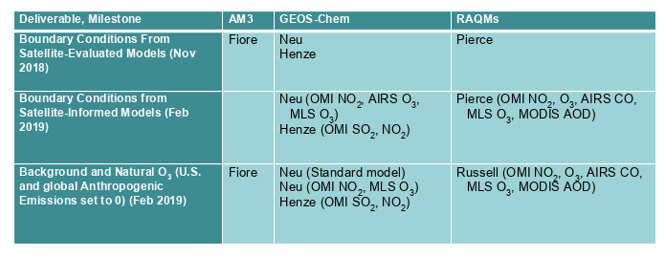
Status Report for RTOWG
Preliminary milestones for background ozone NASA HAQAST project

Slide 21
Regional Haze Planning Work Group

Slide 22
Regional Haze Planning Work Group
Co-Chairs: Tina Suarez-Murias (CARB) & Jay Baker (UT DEQ)
Call Schedule: 1st Tuesday every even month, noon-2PM Mountain Time
Website: https://www.wrapair2.org/RHPWG.aspx
Current Activities & Questions:
Reviewing Deliverables against Work Plan Timing
Evaluating Work Group and Subcommittee Coordination, Overlap, and Roles
Figuring out what is needed for TSC Meeting December 4-6, 2018 in Salt Lake City vs. what to cover in December bi-monthly conference call
Transition to training for tool (deliverable) use and SIP writing

Slide 23
Regional Haze Planning Work Group
REGIONAL HAZE (2018 Tasks) | IN PROGRESS | TO DO | ISSUES
Monitor Data Analysis | -Alternatives Analysis for MID Selection -New Natural Conditions | -Glide Path Recalculation -Trends Analysis -States do Species Focus by Site | -EPA Finalizing Tracking Guidance & Natural Conditions versus Subcommittee Analysis -Awaiting Patching/Substitution for Missing Data
Emission Inventory | -States Confirmed 2014 Inventories for most categories | -Oil & Gas (Spring 2019) -Smoke & Fire (Spring 2019) -2028 Forecast and Trends | -Using EPA 2028 forecast from 2016 vs. 2014 -Multi-year Average Categories -Boundary Conditions & International Emissions
Air Quality Modeling | -Developing Categories for Source Apportionment | -Average multi-year categories -2014 Meteorology Model -Calculating RRF with MIDs | -Interplay of RHPWG & RTOWG for RH modeling -Reconciling work with EPA modeling -Is WEP affordable?
Source Analysis for Controls | -Screening Protocol | -Visibility as a Fifth Factor -Control Option “Clearinghouse” | -States must do their own Analysis and have Emissions Reductions results by Fall 2019
Shared Database | -TSS v.2 in development -First Training Webinar Oct. 5 | -Assist Contractor with support Documents | -“Freezing” Data for Planning Purposes -Storing & Linking Reference Materials
Consultation & Coordination | -White Paper on Protocols | -Coordinate Training Modules -Contacts & Links | -Will Timeline & Work Plan help pace progress -Nexus between Tools, Training, & SIP Production

Slide 24
Regional Haze Planning Work Group
Monitoring Data & Glide Path Status Report
Approach
  Evaluate proposed EPA tracking metric with alternative extreme episodic event (E3) thresholds and other options for selecting the 20% Most Impaired Days (MID) in the west
  Set up Excel spreadsheet and R code analysis to test variables on 26 representative IMPROVE sites, which each State can use to analyze their IMPROVE sites using FED dataset
  Develop methodologies for evaluating Natural Condition alternative estimation techniques for future testing
Status
  Prepared draft list of alternative approaches to MID metric with pros and cons for each
  Contractor support to develop data substitution methodologies
  Exploring ideas for natural condition estimation
  Updating data evaluation tools to include 2017 datasets
  Preparing draft summary documentation of work completed to date
Milestones
  Subcommittee summary document scheduled for release prior to Dec TSC meeting
  Contractor to prepare report documenting data patching and data substitution
Coordination and Next Steps and Tasks
  Draft summary document for feedback from RHPWG (all states, FLMs, tribes, EPA)
  Research methodologies for Baseline and 2064 Natural Conditions adjustment (Glide Path slope and endpoints)
  Coordinate with Modeling and Emission Inventory subcommittee to determine metric needs for modeling
  Roll out contractor data substitution recommendations to all States for review and feedback
Notes:
Consultant on Board to assist with data patching and Substitution needed to make the planning dataset complete

Slide 25
Regional Haze Planning Work Group
Shared Database Status Report
Approach
  Assure that publically accessible database has useful information for states to use in SIP preparation
  Work with CIRA contacts to share state needs and evaluate design of TSS v.2
Status
  Reviewing Haze Analysis Tools on draft TSS v.2
  Comments compiled for CIRA collaborator’s monthly response
  Developing documents for eventual resource links on TSS v.2 (coordinate with other subcommittees)
Milestones
  Haze Analysis Tools, although still draft, should be helpful to states now
  TSS v.2 Progress Report Webinar presented October 5, 2018 (recording available at https://www.wrapair2.org/pdf/TSSv2Oct5_2018ProgressReport%20recording.mp4)
  Draft glossary available on TSS v.2 – will be updated
Coordination and Next Steps
  Working with RHPWG on coordinating documentation needs
    Expanded coordination with other subcommittees needed to ensure documentation needs are met with little (or no) overlap
  Collaborators continue to develop updates for us to review – running list of most recent updates on home page of TSS v.2
    Subcommittee will continue to suggest improvements through the SC lead
Notes:
The Shared Database Subcommittee is working with the contractors at Colorado State on Technical Support System v2. with the hope of presenting it to the Regional Haze Work Group at the October 2 Conference Call of the Regional Haze Work Group.
They caution that the algorithms behind the display might change the final values displayed as the Monitoring and Glide Path subcommittee and the contractors verify the input values.
Some data patching and substitution may be needed at some monitors, if they do not have a complete year that is critically needed.

Slide 26
Regional Haze Planning Work Group
Emissions Inventory & Modeling Protocol Status Report
Approach
  Collect and collate emissions data from all states (2014 and future forecasts)
  Photochemical modeling for CONUS western states
Status
  State comments/revisions on emissions are being used to create documentation for the modeling contractor
  Photochemical modeling contract reviewed before release
Milestones
  Identified categories needing further attention (unpaved road dust, unreported minor sources)
  Completed review of 2014 NEI v2 and compiled revisions requested by states
Coordination and Next Steps
  Set deadline to grid out 2014 inventory for regional photochemical modeling
  Work with RTO Work Group to secure contractor for baseline and future year modeling
  Get 2014 data from Oil & Gas and Fire & Smoke Work Groups model-ready by Spring 2019
  Coordinate with Fire & Smoke Work Group on multi-year averages to use for future year modeling
Notes:
Milestone changed because inventory complete except for Smoke & Fire and Oil & Gas due to be finished this spring

Slide 27
Regional Haze Planning Work Group
Control Measures Status Report
Approach
  Develop Reasonable Progress Protocol for States to identify and assess emissions reductions from Non-Mobile Anthropogenic Sources within their State
  Develop means to demonstrate these reductions improve visibility in Class I Areas
Status
  Interpret EPA proposed guidance for 80% of non-mobile anthropogenic sources (facility/unit/source category)
  Propose screening tools to identify sources (e.g. generally focus on SO2, SO4, NOx, and PM pollutants > 100 tpy; evaluate source emissions over distance from CIA: “Q/d > x” and confirm sources with WRAP WEP analysis)
Milestones
  Develop and circulate schedule for States’ input to other Work Groups and contractors (pending)
  Draft WRAP Reasonable Progress Source Identification and Analysis Protocol to be shared with RHPWG soon
Coordination and Next Steps
  Circulate Screening Techniques “menu” as working draft to states for use as guidance selecting “target sources”
  Review four-factor methods and options;
  Work with other Work Groups on multi-year emissions averaging if needed for cost-benefit analysis or modeling
  Reconcile Area Source Emissions categories vs. Stationary Source facilities with multiple units for control analysis
  Determine needs for contractor assistance
Notes:
-Hope the Protocol will be ready by beginning of December

Slide 28
Regional Haze Planning Work Group
Consultation and Coordination Status Report
Approach
  Recommend a framework for State/State, State/Local Air Agency, State/ FLM consultation and for coordination with EPA and Tribes
  Provide potential ideas for communication and outreach with stakeholders and the public
Status
  Webpage updated:
    list of key contacts at all agencies (to be updated with tribal contacts list from TDWG later this year)
    links to key resources for states/locals/tribes
  Drafted timeline of informal consultation junctures during SIP development
  Working on draft white paper laying out the consultation & coordination framework
Milestones
  General Contract ($25,000) includes formal consultation requirements related to states’ public review procedures & schedules (State SIP Readiness)
Coordination and Next Steps
  Invited TDWG contractors to participate in subcommittee calls to help coordinate communication efforts
  Continue coordination with other subcommittees on timing of work products for review and presentation
  Next Step: prepare draft communication framework and timeline for discussion at December TSC meeting
Notes:
States were to submit their survey answers by October 22

Slide 29
End of Workplan Progress Update

